Slide 1
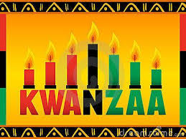
Kwanzaa
Student Health & Human Services
Office of Human Relations, Diversity & Equity
June 2022

Slide 2
Would You Rather...
Be able to see 10 minutes into your own future
Be able to see 10 minutes into everyone else's futures.

Slide 3
Objectives
Learn the history of Kwanzaa & why it was created
Identify why people celebrate it

Slide 4

The History of Kwanzaa
Dr. Maulana Karenga introduced the festival in 1966 to the United States as a ritual to welcome the first harvests to the home.
Dr. Karenga created this festival for Afro-Americans as a response to the commercialism of Christmas.

Slide 5
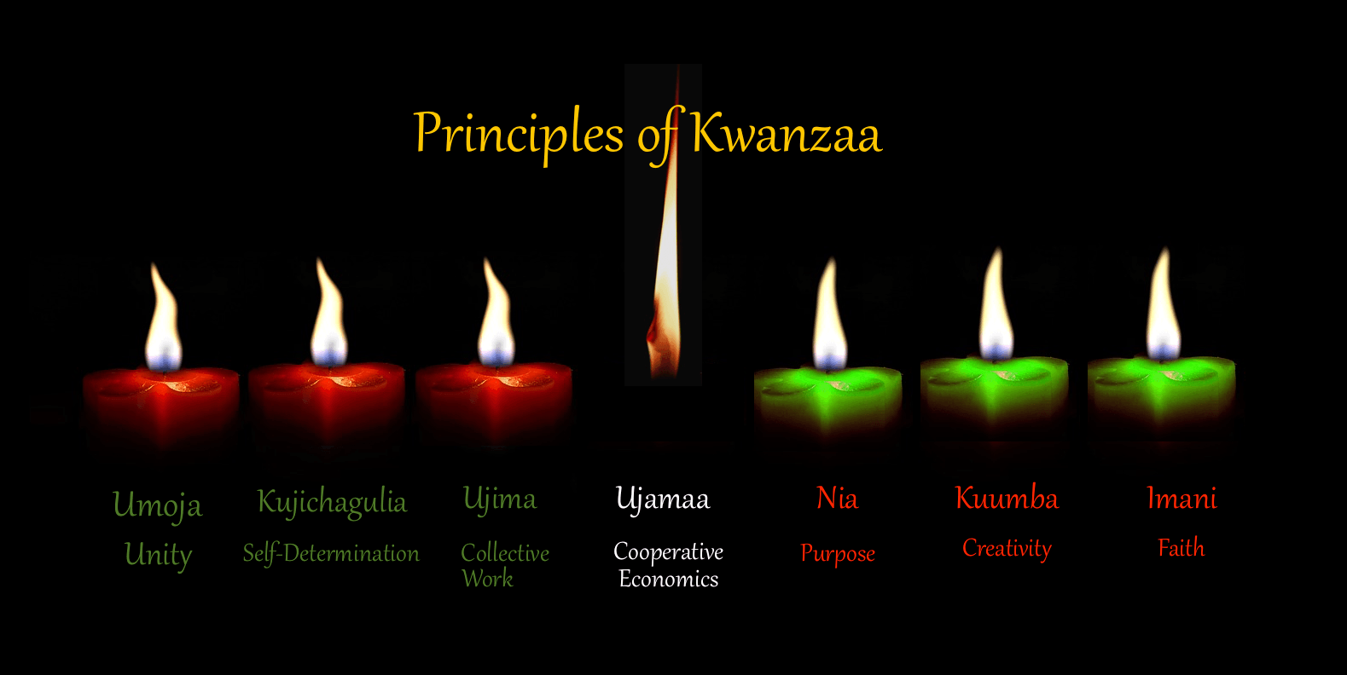
What is Kwanzaa?
Kwanzaa is seven-day celebration from 26 December to 1 January that celebrates African American culture, history and seven principles.
Each candle signifies a principle.

Slide 6
The Five Common Values
ingathering
commemoration
celebration
reverence
recommitment

Slide 7
The Seven Principles (Nguzo Saba)
unity (umoja)
self-determination (kujichagulia)
collective work and responsibility (ujima)
cooperative economics (ujamaa)
purpose (nia)
creativity (kuumba)
faith (imani)

Slide 8
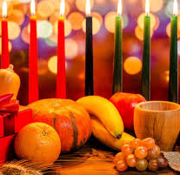
The Symbols
crops (mzao) represent the historical roots of African-Americans in agriculture and the reward for collective labor.
mat (mkeka) lays the foundation for self- actualization.
The candle holder (kinara) reminds believers in the ancestral origins in one of 55 African countries.
Corn/maize (muhindi) signifies children and the hope associated in the younger generation.
Gifts (Zawadi) represent commitments of the parents for the children.
The unity cup (Kkimbe cha Umoja) is used to pour libations to the ancestors.
Finally, the seven candles (mishumaa saba) remind participants of the seven principles and the colors in flags of African liberation movements -- 3 red, 1 black, and 3 green.

Slide 9
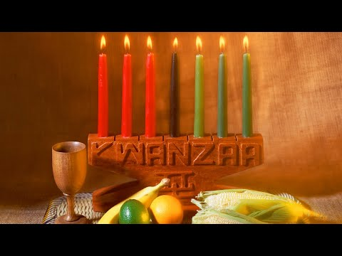
What is Kwanzaa & How Is It Celebrated?

Slide 10

Why do you think this holiday is important to African American people?
Does your culture celebrate something similar?

Slide 11
Activity
Take 10 minutes & create your own holiday. Answer the following questions.
What would be the symbols?
Why should it be celebrated?
When would it be celebrated?

Slide 12
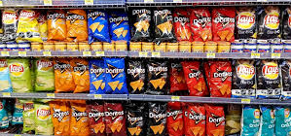
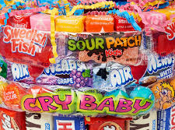
Chips or Candy?

Slide 13
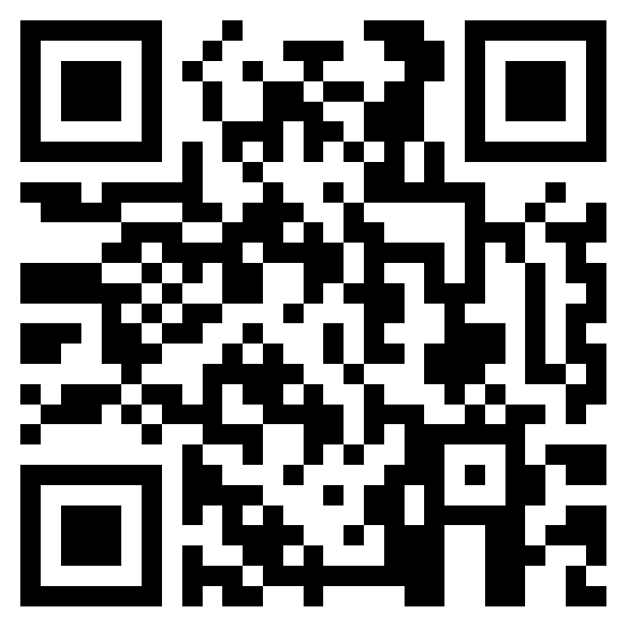
Teacher Feedback Survey
Notes:
Teacher, please scan the QR code or click the link below to complete the feedback survey.
https://forms.office.com/r/i9UqyyxzTT

Slide 14

Office of Human Relations, Diversity & Equity

